Slide 1

Inclusive Design
Jose Arturo Lemus Ortiz, Tara MacKenzie, Sammy Levy, Tommaso Lombardi

Slide 2
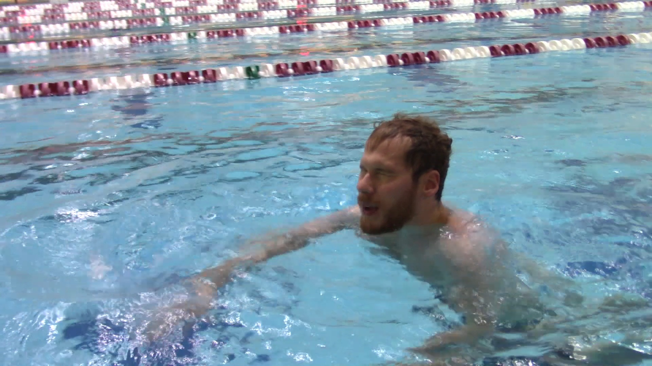
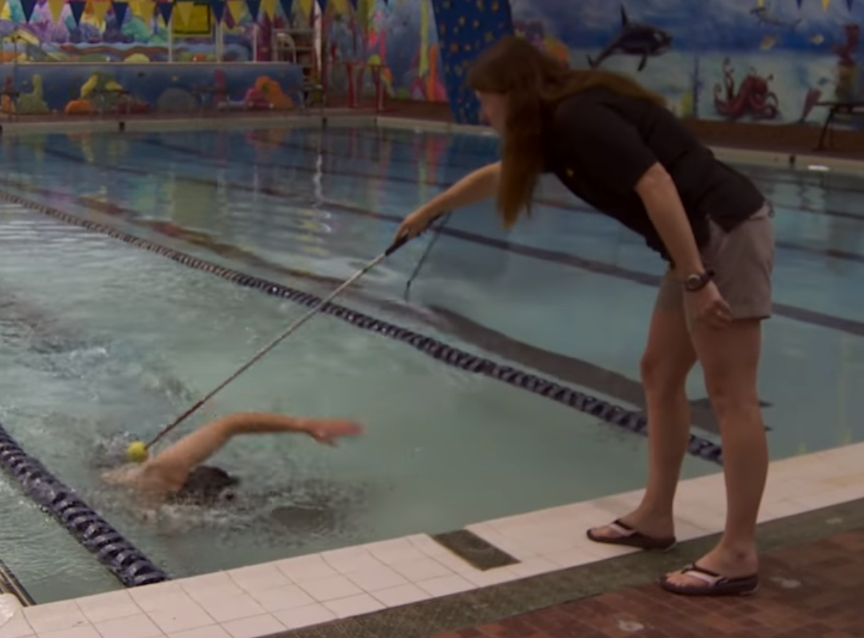
Background
Blind swimmers
Limited assistive devices (canes, guide dogs)
Problems
Colliding against walls
Avoiding lane dividers and obstacles
Confidence
Tappers
Uncomfortable
Requires additional people

Slide 3
Goals
Find a more effective way to deliver feedback to blind swimmers
Help make blind swimmers more independent
Eliminate the need for tappers

Slide 4
Design and Prototyping

Slide 5
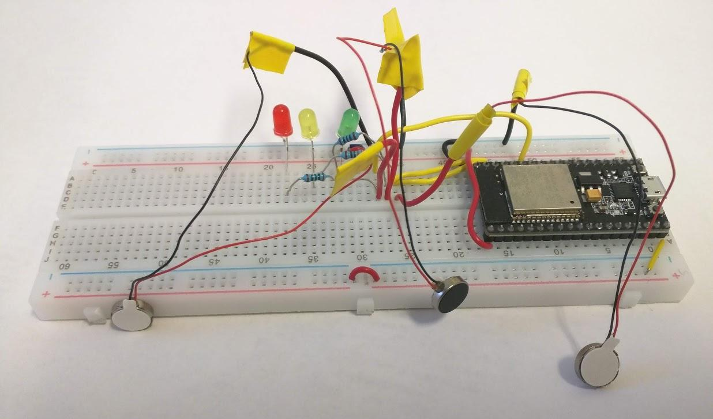
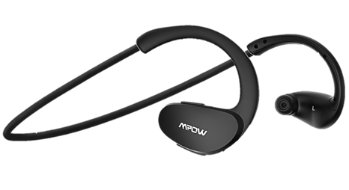
Feedback Methods
Haptic
Head
Wrist
Vibration motors and microcontroller
Auditory
Directional beeps
Verbal

Slide 6
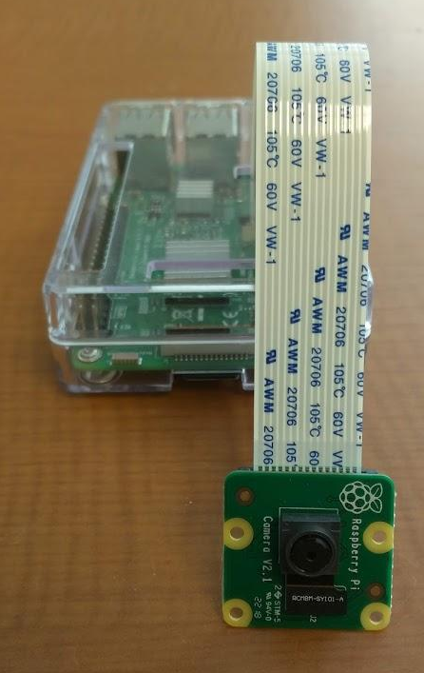

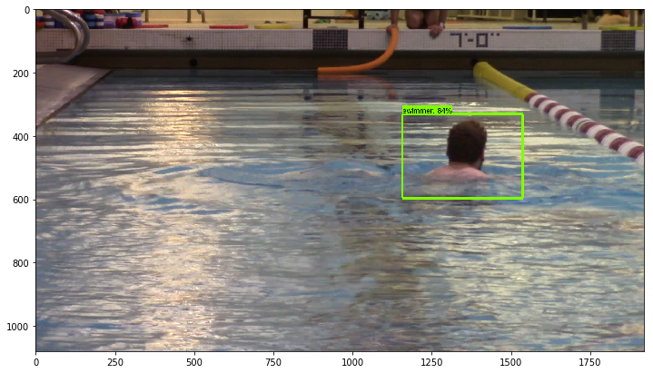
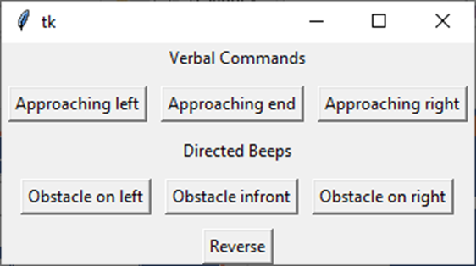
Controllers
Manual
Human operator
Smartphone or computer
Tkinter
Automatic
Object-recognition model
Raspberry Pi
TensorFlow and related libraries

Slide 7
User Testing

Slide 8
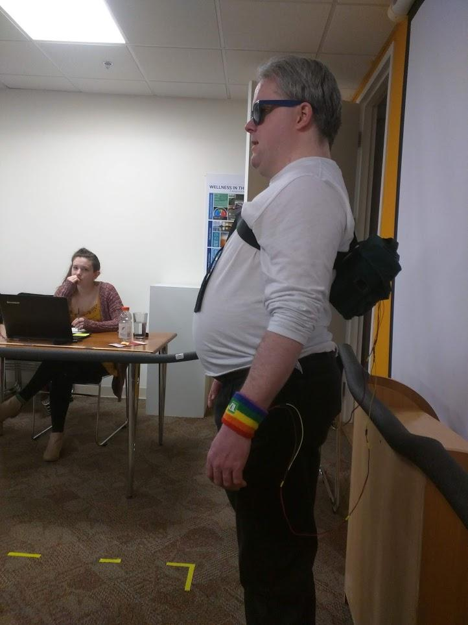
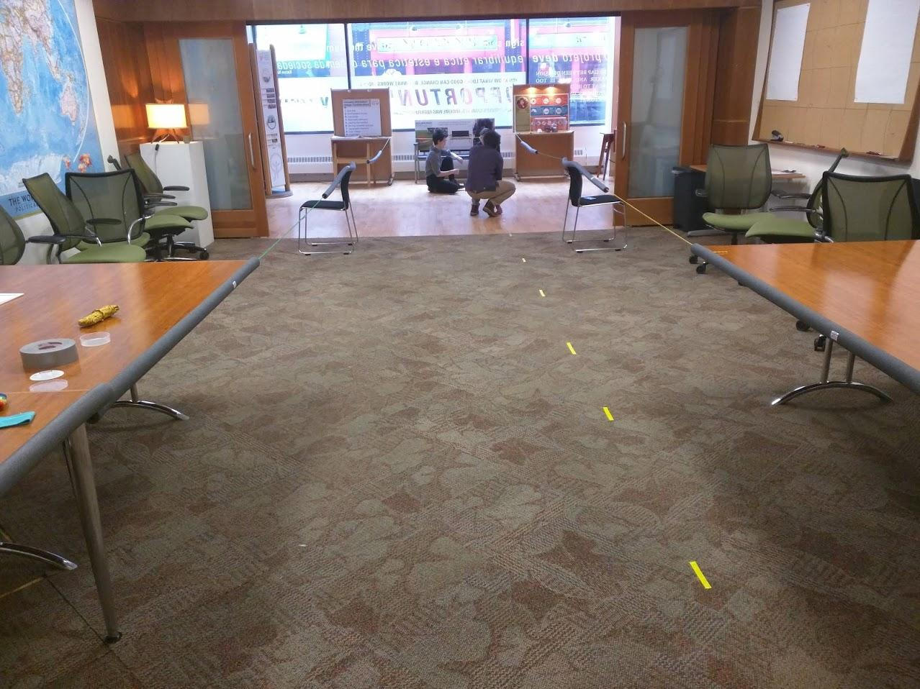
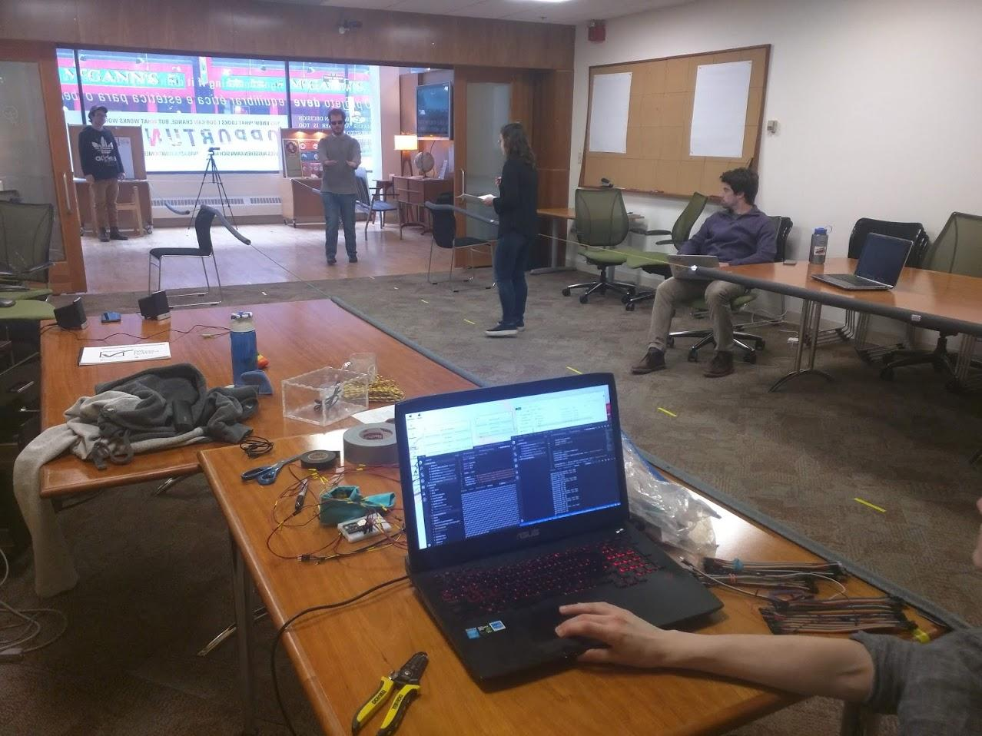
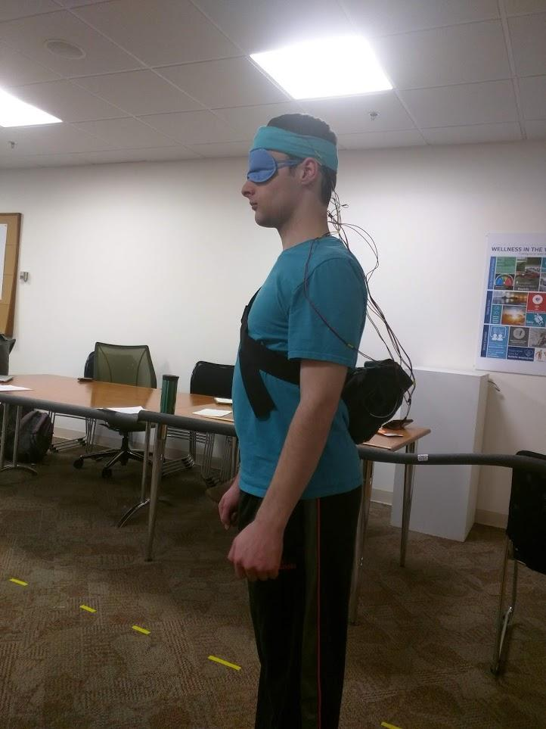
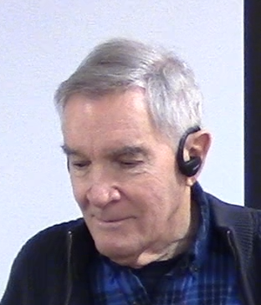
User Testing

Slide 9
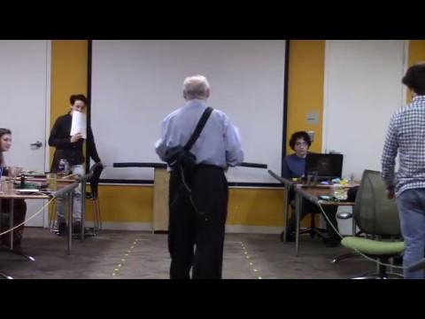
Test on fully blind participant using manually controlled haptic feedback wristbands.

Slide 10
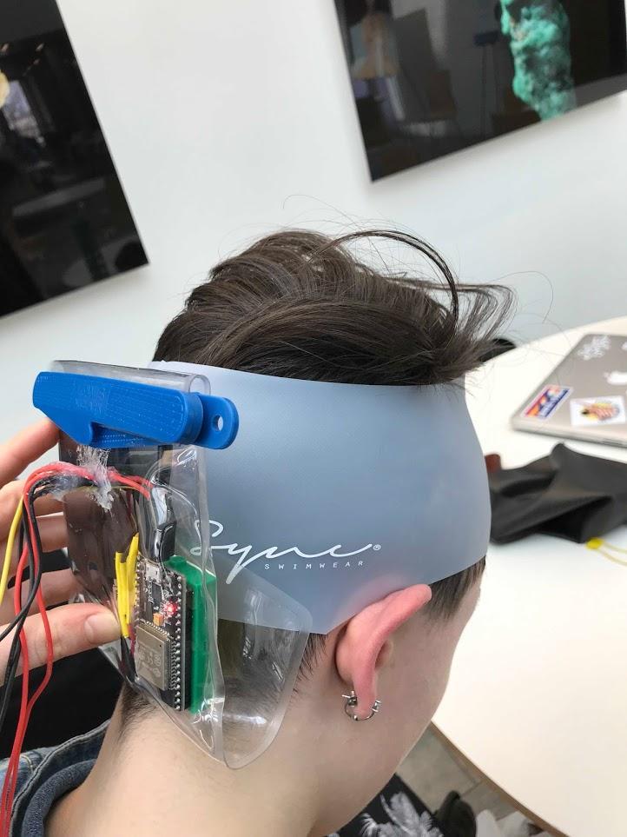
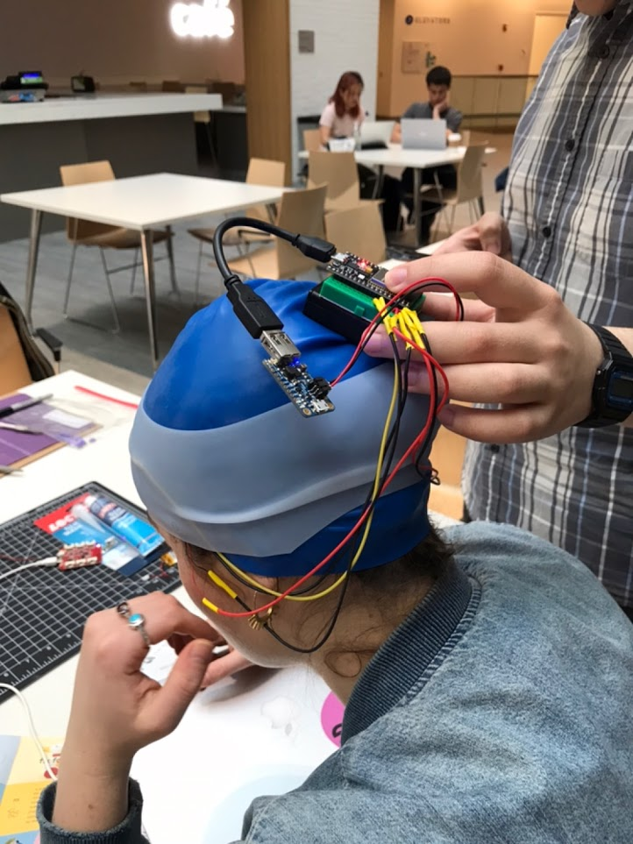
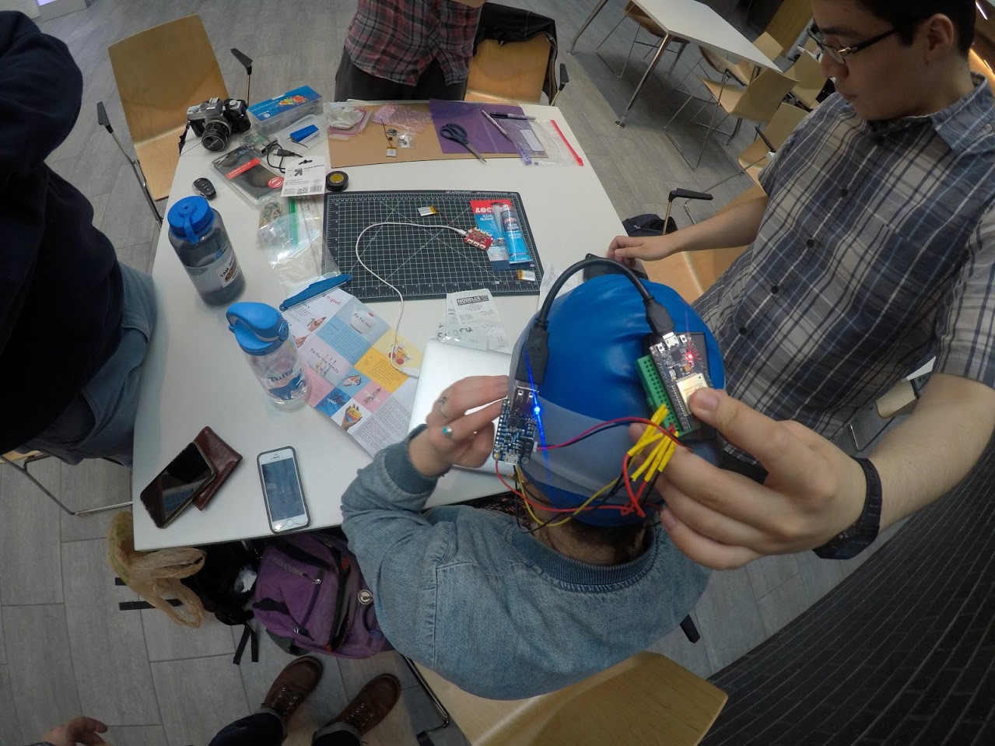
Redesign

Slide 11
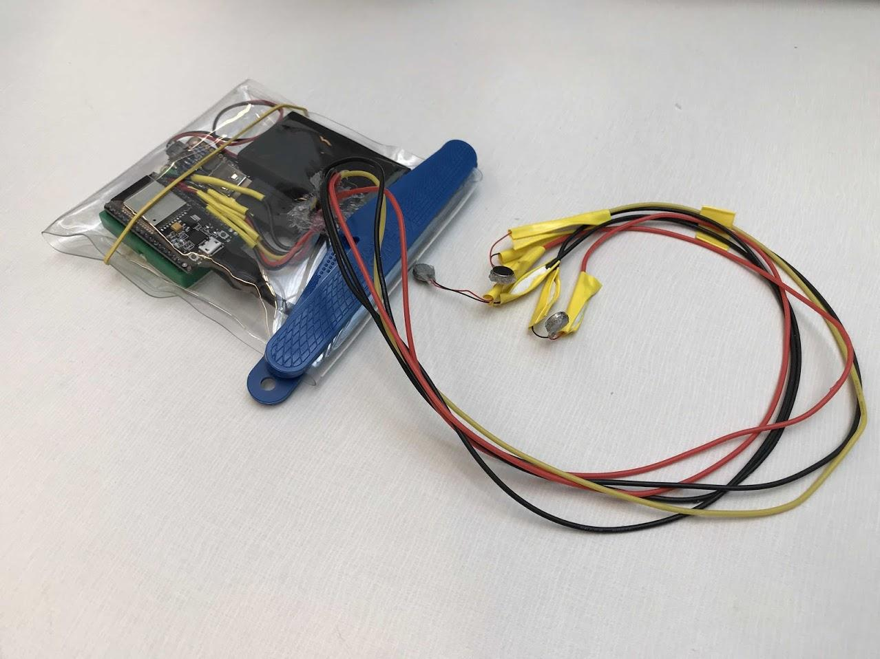
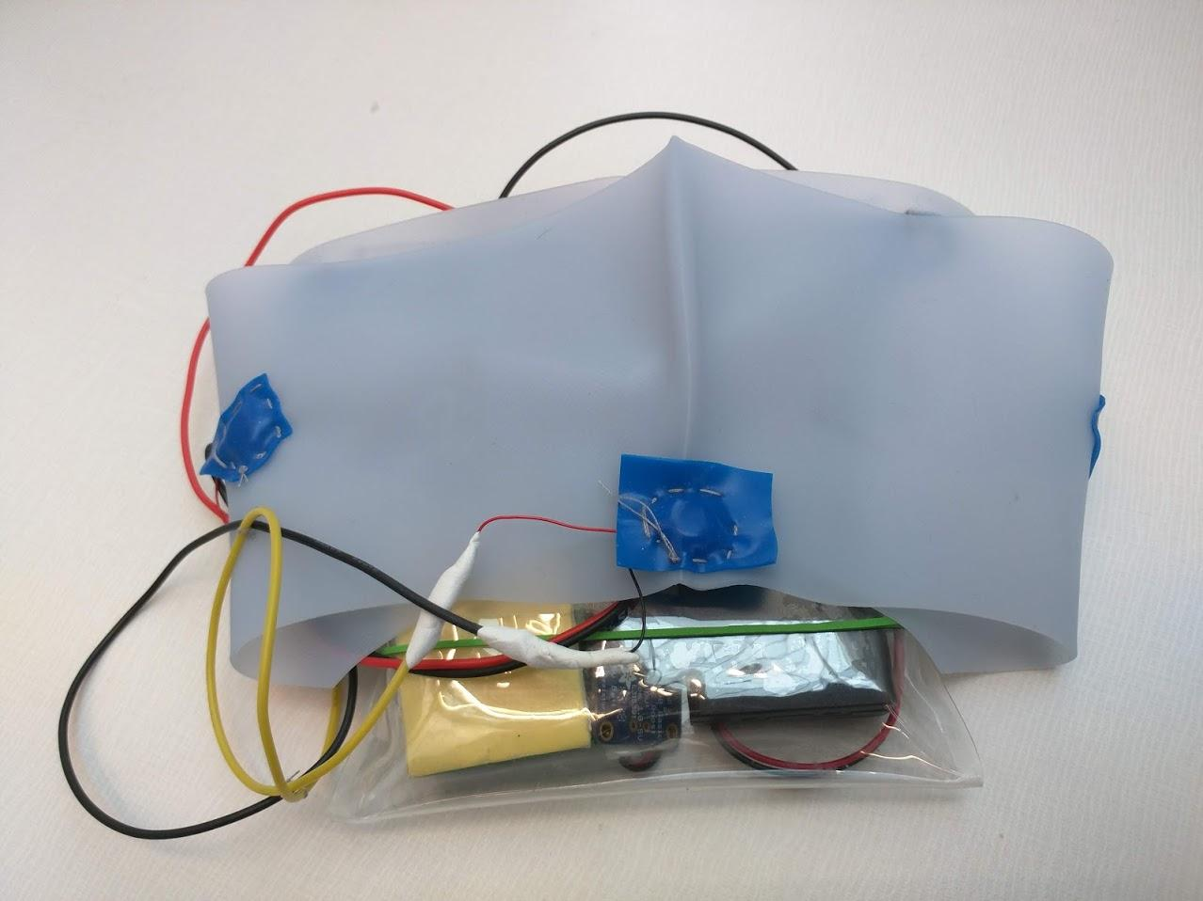
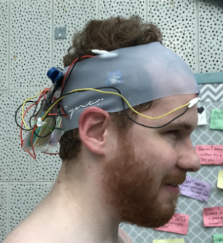
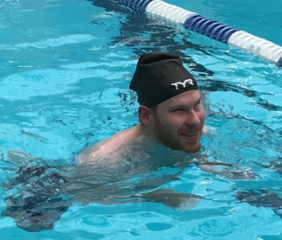
Final prototype
Haptic
Faster response time
Lowest error rate
Headband
Less likely to be ignored
Waterproof
Manual control scheme completed

Slide 12
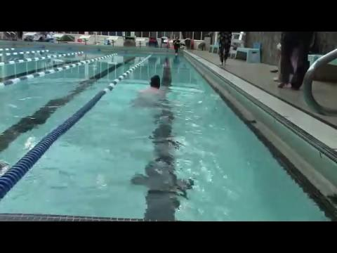
Test subject swimming with final version of device. It is being manually triggered using a phone by an experimenter walking along the pool.

